Slide 1

Project #1
Vancouver Whales

Slide 2
Introduction
NBA commissioner Adam Silver has accepted Vancouver Whales proposal for a 2021 new expansion team.
The proposal outlines:
All active NBA players become free agents.
Player’s salary will be equivale to last year’s salary
Player’s can be recruited any team

Slide 3
Team Proposal
Elon Musk, the owner of the Vancouver whales, wants to assemble a winning team for the 2021 season. He has hired Lucy Luo, Ryan Worm, and Tom Nierodzik to assemble a team based off analysing players statics and data trends
Proposal #1 : “The Dream Team”
Proposal #2 : “Offensive, Offensive, Offensive”
Proposal #3 : “The best Offensive is a great Defence”
Proposal #4 : “Money Ball”

Slide 4
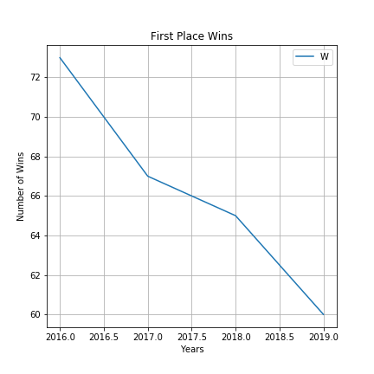
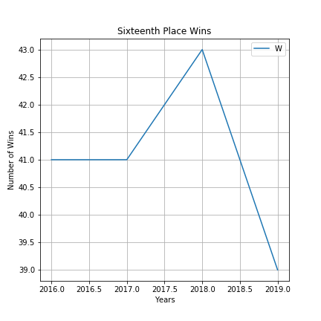
Winning Roster
Determine a range of wins required to assemble a winning roster
The average Number of wins required to get first place is 67 wins based off data from 2016 to 2019
The average Number of wins required to get sixteenth place is 41.0 wins based off data from 2016 to 2019
The winning roster needs to have at least 41 wins

Slide 5
Proposal #1 : “Dream Team”
Step #1 – Determine the Number of Wins required for first place in the league based of the last five years.
The average Number of wins required to get first place is 67 wins

Slide 6
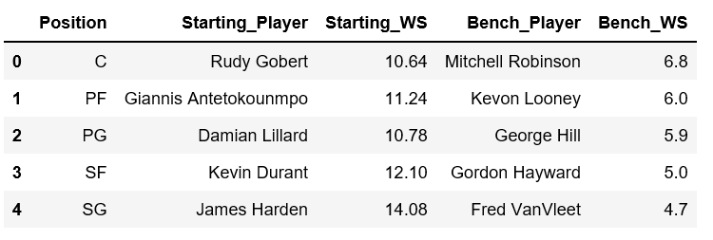
Proposal #1 : “Dream Team”
Step #2: Determine players per position with the highest average WS (Win Share) in the last five years

Slide 7
Proposal #1 : “Dream Team”

Slide 8
Proposal #1 : “Dream Team”

Slide 9
Proposal #2 : “Offensive, Offensive, Offensive”

